Slide 1
Chart 1: Australian COVID-19 cases, key events and ABS data releases

Slide 2
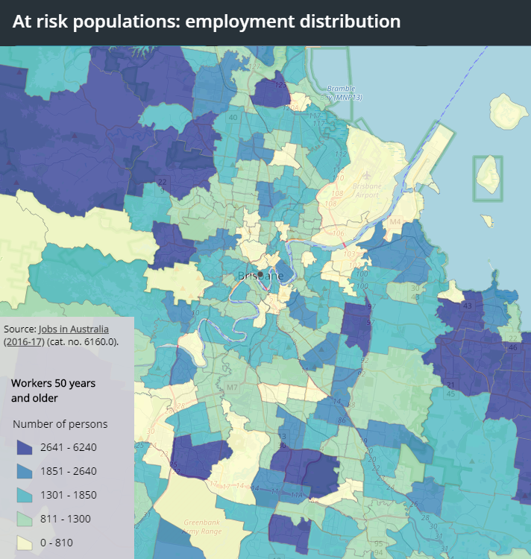
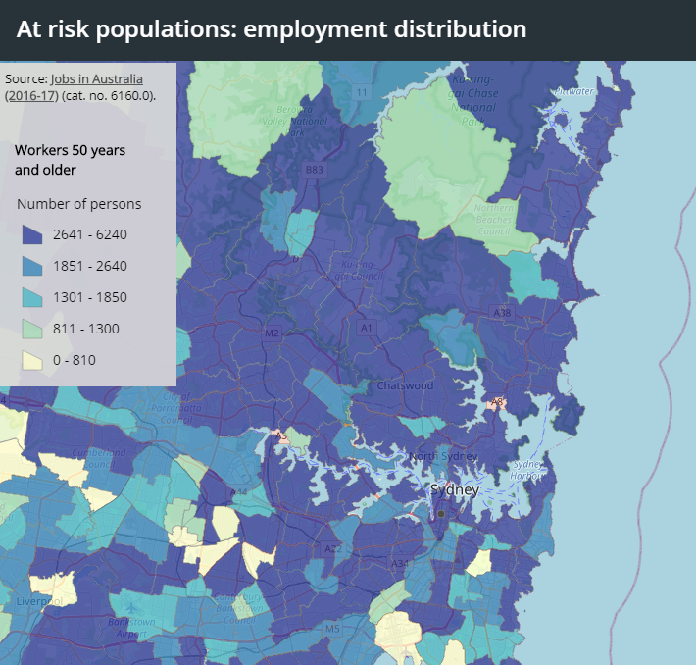
Chart 2: Interactive maps – employment distribution Example of total employment 50 years and older
Brisbane, Queensland
Sydney, New South Wales

Slide 3
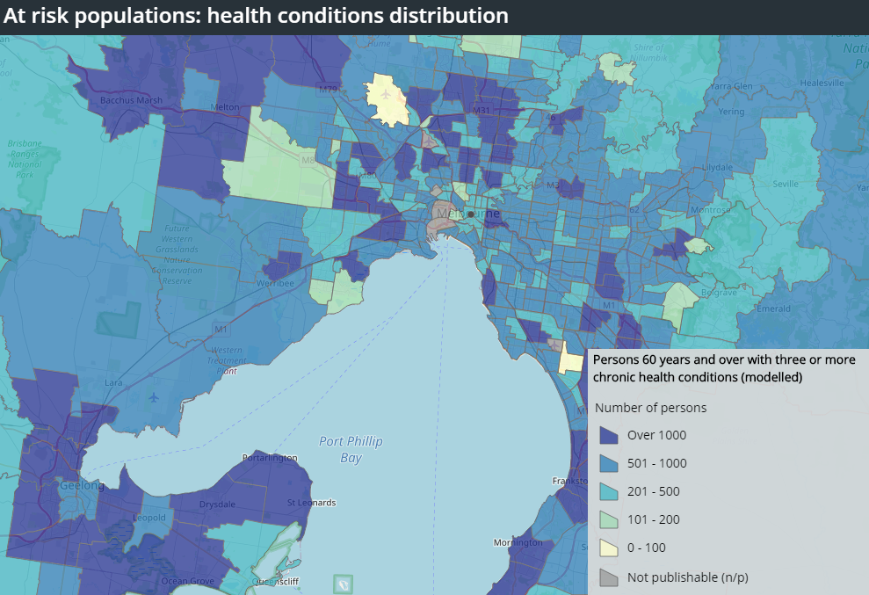
Chart 3: Interactive maps - Health conditions distribution Example of Persons 60 years and over with three or more chronic health conditions (modelled)
Melbourne, Victoria

Slide 4
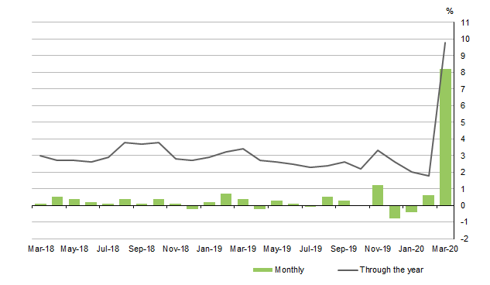
Chart 4: Retail turnover, current prices, seasonally adjusted, percentage change (preliminary)
Source: Retail Trade, Australia, Preliminary, March 2020

Slide 5
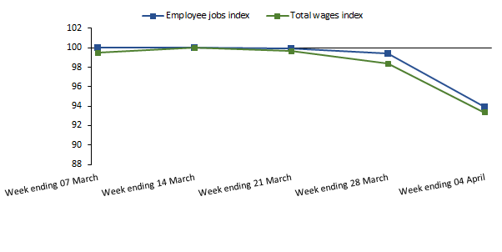
Chart 5: Changes in employee jobs and total wages indexed to the week ending 14 March 2020
Source: Weekly Payroll Jobs and Wages in Australia, Week ending 4 April 2020

Slide 6
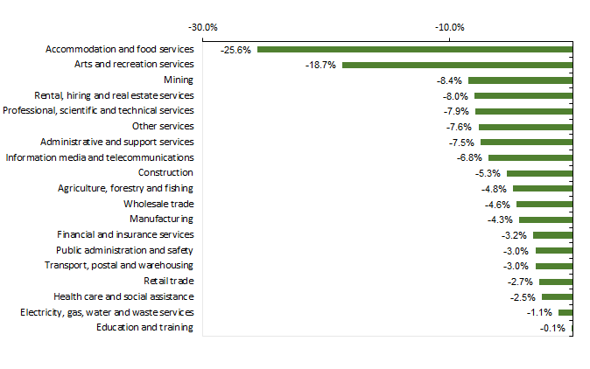
Chart 6: Changes in employee jobs between 14 March and 4 April, by industry
Source: Weekly Payroll Jobs and Wages in Australia, Week ending 4 April 2020

