Slide 1
Chart 1: Behavioural insights applied to the Labour Force Survey
c

Slide 2
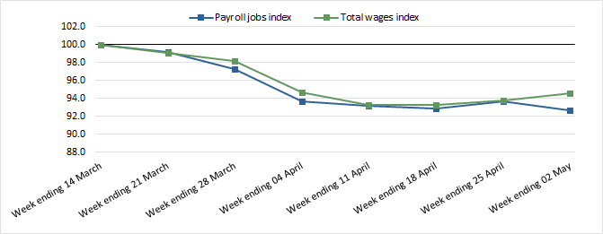
Chart 2: Changes in payroll jobs and total wages indexed to the week ending 14 March 2020
Source: Weekly Payroll Jobs and Wages in Australia, Week ending 2 May 2020

Slide 3
Chart 3: Changes in payroll jobs by industry since 14 March 2020
Source: Weekly Payroll Jobs and Wages in Australia, Week ending 2 May 2020

Slide 4
Chart 4: How AIR (machine learning) is improving Address Register processes

Slide 5
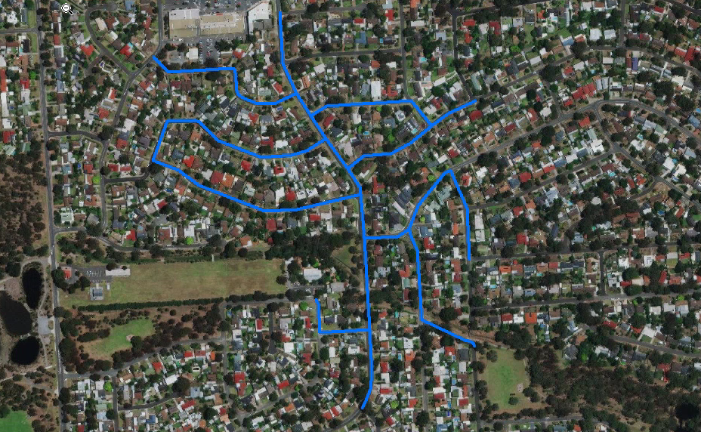
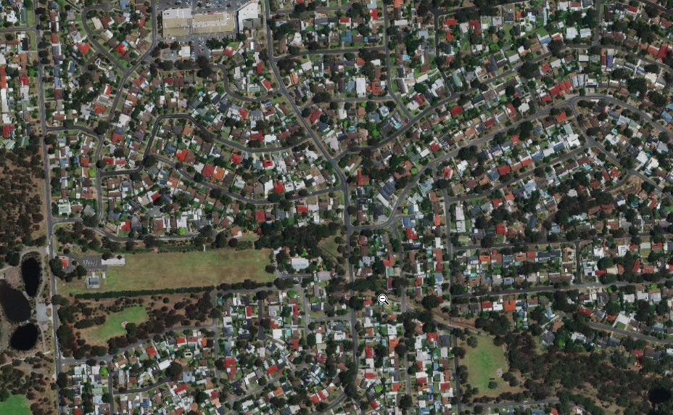
Geo-statistics in the 2017-18 National Health Survey
Adding new data items to the 2017-18 National Health Survey
Access to supermarkets
Access to fast food outlets
Access to Public Space
Developed in consultation with the Health Research Institute at the University of Canberra
Supermarkets
Road network within 400 metres
Fast food outlets
Address Location linked to other data
Network service area (400 m)
Public open space

